Slide 1
Clustering

Slide 2
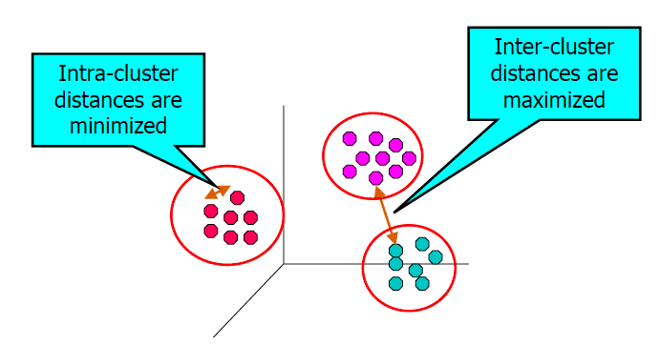
The Problem of Clustering
Clustering is a technique for finding similarity groups in data, called clusters.
Groups data instances that are
Similar to (near) each other in one cluster, and
Very different (far away) from each other into different clusters.
Clustering is an unsupervised learning task as no class values denoting an a priori grouping of the data instances are given, which is the case in supervised learning.

Slide 3
Unsupervised learning: clustering
Raw data
Features
f₁, f₂, f₃, …, f_{n}
f₁, f₂, f₃, …, f_{n}
Clusters
f₁, f₂, f₃, …, f_{n}
f₁, f₂, f₃, …, f_{n}
group into classes/clusters
extract
features
f₁, f₂, f₃, …, f_{n}
No “supervision”, we’re only given data and want to find natural groupings

Slide 4
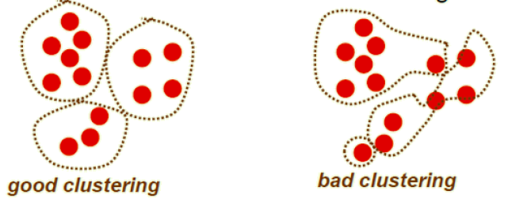
What do we need for clustering?
Proximity measure, either
Similarity measure s(x₁, x₂) - large if x₁,x₂ are similar
Dissimilarity (or distance) measure d(x₁,x₂) – small if x₁,x₂ are similar
Criterion function to evaluate a clustering
Algorithm to compute clustering
For example, by optimizing the criterion function

Slide 5
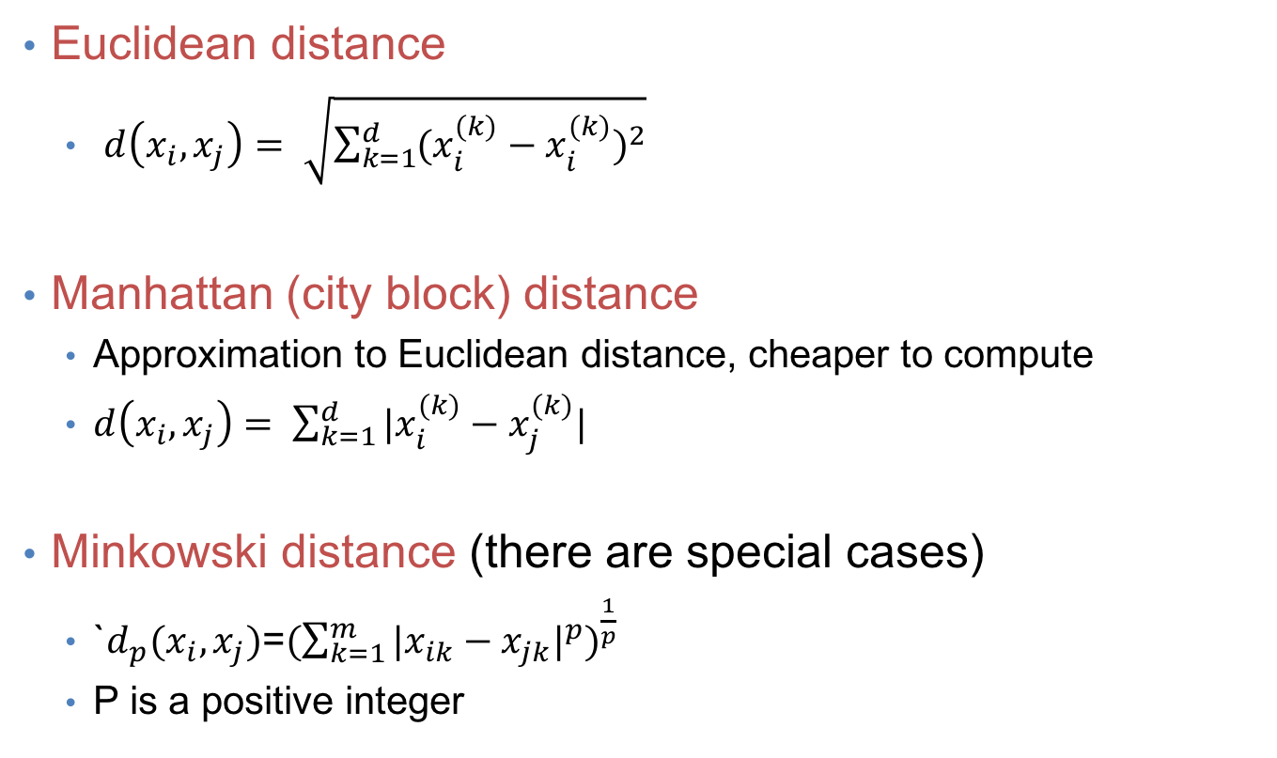
Distance (dissimilarity) measures
Euclidean distance
$d\left(x_{i},x_{j}\right)= \sqrt{\sum_{k=1}^{d}{{(x_{i}^{(k)}−x_{i}^{(k)})}^{2}}}$
Manhattan (city block) distance
Approximation to Euclidean distance, cheaper to compute
$d\left(x_{i},x_{j}\right)= \sum_{k=1}^{d}{|x_{i}^{(k)}−x_{j}^{(k)}|}$
Minkowski distance (there are special cases)
`$d_{p}(x_{i},x_{j})$=${(\sum_{k=1}^{m}{{|x_{ik}−x_{jk}|}^{p}})}^{\frac{1}{p}}$
P is a positive integer

Slide 6
Cluster evaluation (a hard problem)
Intra-cluster cohesion(compactness):
Cohesion measures how near the data points in a cluster are to the cluster centroid.
Sum of squared error (SSE) is a commonly used measure.
Inter-cluster separation(isolation):
Separation means that different cluster centroids should be far away from one another.
In most applications, expert judgments are still the key

Slide 7
Clustering Techniques
Clustering
Hierarchical
Bayesian
Partitional
Decision Based
Nonparametric
Divisive
Agglomerative
Centroid
Model Based
Spectral

Slide 8
Applications of clustering
Understanding
Grouping objects into conceptually meaningful classes is an important step in analysis.
EX: Group related documents for browsing, group genes and proteins that have similar functionality, or group stocks with similar price fluctuations.
Summarization
Reduce the size of large data sets
EX: PCA requires space complexity O(m²) so may not be practice for large datasets. We can cluster dataset and apply PCA on the cluster prototypes.

Slide 9
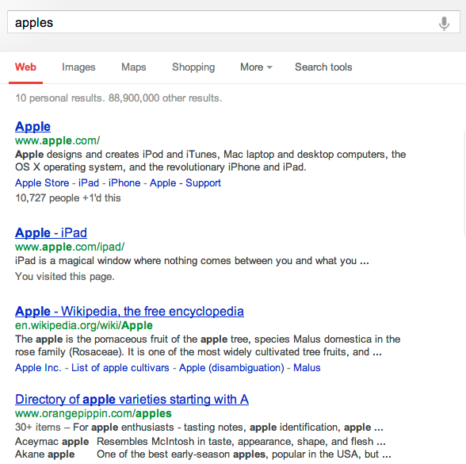
Applications (clustering for IR)
Documents or webpages in the same cluster are likely to be similar.

Slide 10
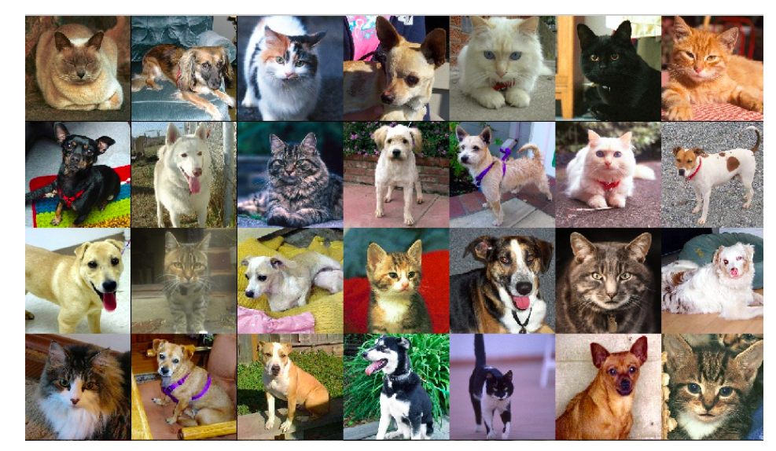
Application – Clustering for image search
Given a collection of unlabeled objects(images), cluster them into groups.
So that given an image, we call pull similar images from the right cluster.

Slide 11
Gene expression data
Data from Garber et al.
PNAS (98), 2001.

Slide 12
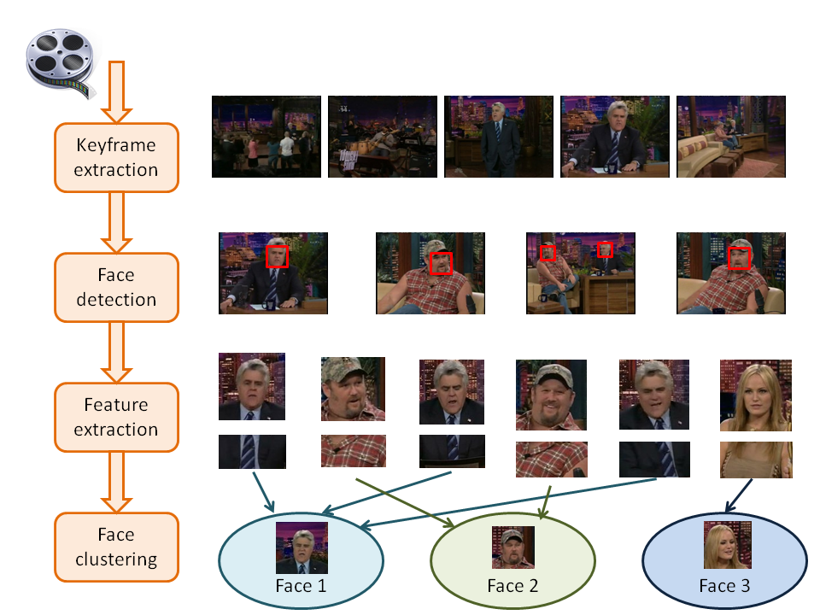
Applications - Face Clustering

Slide 13
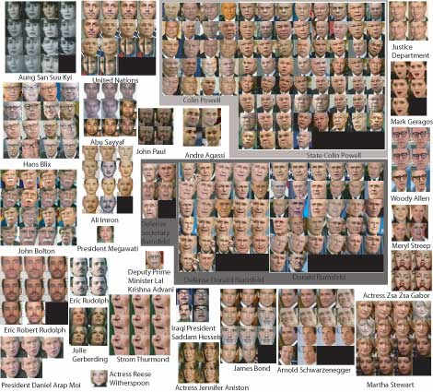
Applications - Face clustering

Slide 14
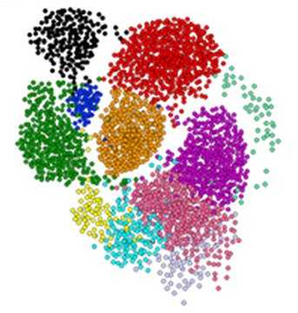
Clustering is a hard problem!

Slide 15
Why is it hard?
Clustering in two dimensions looks easy
Clustering small amounts of data looks easy
And in most cases, looks are not deceiving
Many applications involve not 2, but 10 or 10,000 dimensions
High-dimensional spaces look different: Almost all pairs of points are at about the same distance

Slide 16
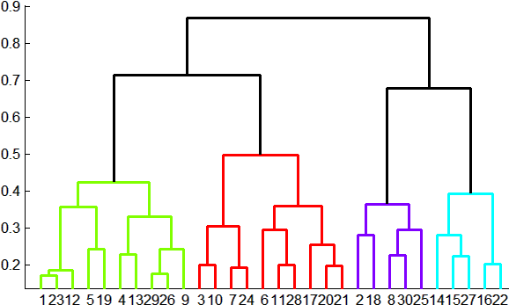
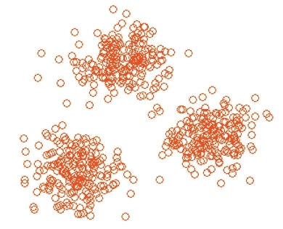
Overview: Methods of Clustering
Hierarchical:
Agglomerative (bottom up):
Initially, each point is a cluster
Repeatedly combine the two “nearest” clusters into one
Divisive (top down):
Start with one cluster and recursively split it
Partitional
Usually start with a random (partial) partitioning
Refine it iteratively
K means clustering
Model based clustering
Bayesian
Try to generate a posteriori distribution over the collection of all partitions of the data.

Slide 17
Hard vs. soft clustering
Hard clustering: Each example belongs to exactly one cluster
Soft clustering: An example can belong to more than one cluster (probabilistic)
Makes more sense for applications like creating browsable hierarchies
You may want to put a pair of sneakers in two clusters: (i) sports apparel and (ii) shoes

Slide 18
Hierarchical Clustering
Key operation: Repeatedly combine two nearest clusters
Three important questions:
1) How do you represent a cluster of more than one point?
2) How do you determine the “nearness” of clusters?
3) When to stop combining clusters?

Slide 19
Hierarchical Clustering
Key operation: Repeatedly combine two nearest clusters
(1) How to represent a cluster of many points?
Key problem: As you merge clusters, how do you represent the “location” of each cluster, to tell which pair of clusters is closest
Euclidean case: each cluster has a centroid = average of its (data)points
(2) How to determine “nearness” of clusters?
Measure cluster distances by distances of centroids

Slide 20
Example: Hierarchical clustering
(5,3)
o
(1,2)
o
o (2,1) o (4,1)
o (0,0) o (5,0)
x (1.5,1.5)
x (4.7,1.3)
x (1,1)
x (4.5,0.5)
Data:
o … data point
x … centroid
Dendrogram

Slide 21
And in the Non-Euclidean Case?
What about the Non-Euclidean case?
The only “locations” we can talk about are the points themselves
i.e., there is no “average” of two points
Approach 1:
(1) How to represent a cluster of many points? clustroid = (data)point “closest” to other points
(2) How do you determine the “nearness” of clusters? Treat clustroid as if it were centroid, when computing inter-cluster distances

Slide 22
“Closest” Point?
(1) How to represent a cluster of many points? clustroid = point “closest” to other points
Possible meanings of “closest”:
Smallest maximum distance to other points
Smallest average distance to other points
Smallest sum of squares of distances to other points
For distance metric d clustroid c of cluster C is:
Datapoint
Centroid
X
Centroid is the avg. of all (data)points in the cluster. This means centroid is an “artificial” point.
Clustroid is an existing (data)point that is “closest” to all other points in the cluster.
Clustroid
Cluster on 3 datapoints

Slide 23
Implementation
Naïve implementation of hierarchical clustering:
At each step, compute pairwise distances between all pairs of clusters, then merge
O(N³)
Careful implementation using priority queue can reduce time to O(N² log N)
Still too expensive for really big datasets that do not fit in memory

Slide 24
k-means clustering
Demo of K-means clustering : http://www.onmyphd.com/?p=kmeans.clustering&ckattempt=2

Slide 25
K-means
Given k, the k-means algorithm works as follows:
Choose k(random) data points (seeds) to be the initial centroids, cluster centers
Assign each data point to the closest centroid
Re-compute the centroids using the current cluster memberships
If a convergence criterion is not met, repeat steps 2 and 3

Slide 26
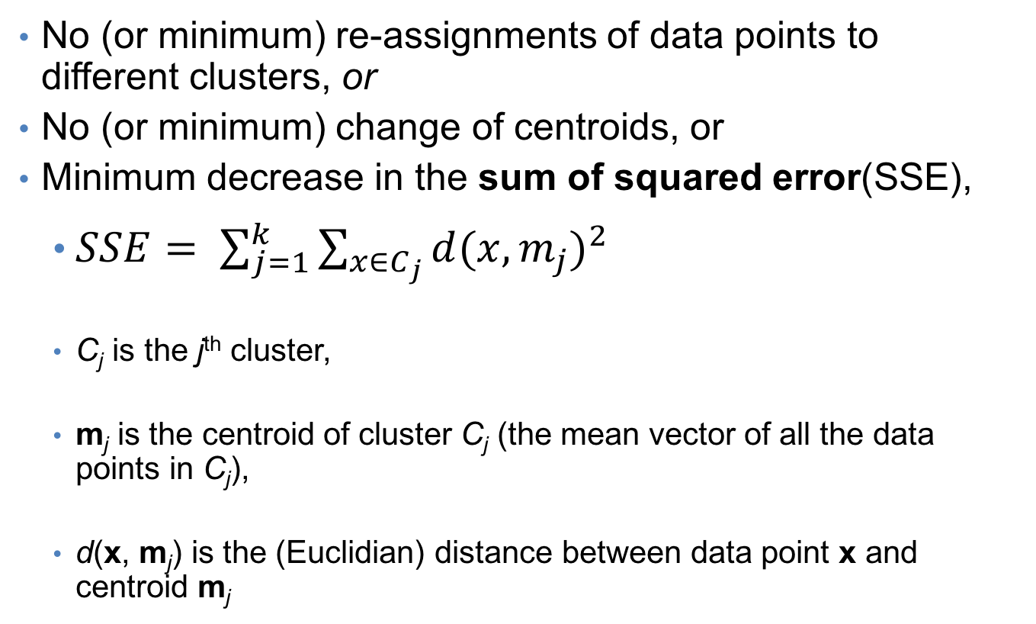
K-means convergence (stopping) criterion
No (or minimum) re-assignments of data points to different clusters, or
No (or minimum) change of centroids, or
Minimum decrease in the sum of squared error(SSE),
$SSE= \sum_{j=1}^{k}{\sum_{x∈C_{j}}{{d(x,m_{j})}^{2}}}$
C_{j} is the j^{th} cluster,
m_{j} is the centroid of cluster C_{j} (the mean vector of all the data points in C_{j}),
d(x, m_{j}) is the (Euclidian) distance between data point x and centroid m_{j}

Slide 27
K-means: an example

Slide 28
Randomly Initialize the cluster centers
Iterate:
Assign/cluster each example to closest center
Recalculate centers as the mean of the points in a cluster

Slide 29
Iteration # 1
Assign each item to closest cluster center
Recalculate centers as the mean of the points in a cluster
iterate over each point:
- get distance to each cluster center
- assign to closest center (hard cluster)

Slide 30
After assigning points to nearest center

Slide 31
Iteration # 1 - Assign/cluster each example to closest center - Recalculate centers as the mean of the points in a cluster

Slide 32
Iterate: Assign/cluster each example to closest center Recalculate centers as the mean of the points in a cluster

Slide 33
Iterate: Assign/cluster each example to closest center Recalculate centers as the mean of the points in a cluster

Slide 34
K-means: assign points to nearest center

Slide 35
K-means: readjust centers

Slide 36
K-means: assign points to nearest center
No changes: Done

Slide 37
Distance measures
Euclidean:
good for spatial data

Slide 38
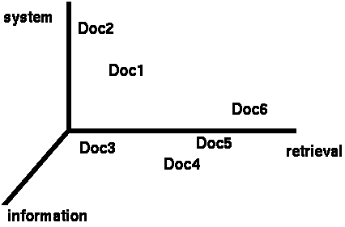
Clustering documents
One feature for each word. The value is the number of times that word occurs.
Documents are points or vectors in this space

Slide 39
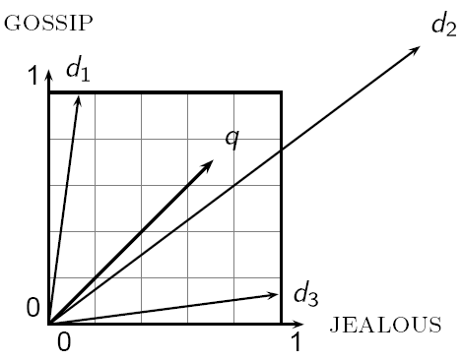
When Euclidean distance doesn’t work
Which document is closest to q using Euclidian distance?
Which do you think should be closer?

Slide 40
Issues with Euclidian distance
the Euclidean distance between q and d₂ is large
but, the distribution of terms in the query q and the distribution of terms in the document d₂ are very similar
This is not what we want!

Slide 41
cosine similarity
correlated with the angle between two vectors

Slide 42
cosine distance
cosine similarity is a similarity between 0 and 1, with things that are similar 1 and not 0
We want a distance measure, cosine distance:
good for text data and many other “real world” data sets
is computationally friendly since we only need to consider features that have non-zero values in both examples

Slide 43
K-means
Iterate:
Assign/cluster each example to closest center
Recalculate centers as the mean of the points in a cluster
How do we calculate these?

Slide 44
K-means
Iterate:
Assign/cluster each example to closest center
Recalculate centers as the mean of the points in a cluster
Mean of the points in the cluster:
where:

Slide 45
Comments on the K-Means Method
Strength
Relatively efficient: O(tkn),
where n is # objects,
k is # clusters, and
t is # iterations.
Normally, k, t << n.
Often terminates at a local optimum.
Weakness
Applicable only when mean is defined, then what about categorical data?
Need to specify k, the number of clusters, in advance
Unable to handle noisy data and outliers
Not suitable to discover clusters with non-convex shapes

Slide 46
K-means loss function
K-means tries to minimize what is called the “k-means” loss function:
that is, the sum of the squared distances from each point to the associated cluster center

Slide 47
Minimizing k-means loss
Iterate:
1. Assign/cluster each example to closest center
2. Recalculate centers as the mean of the points in a cluster
Does each step of k-means move towards reducing this loss function (or at least not increasing)?

Slide 48
Minimizing k-means loss
Iterate:
1. Assign/cluster each example to closest center
2. Recalculate centers as the mean of the points in a cluster
Intuition:
Any other assignment would end up in a larger loss
The mean of a set of values minimizes the squared error

Slide 49
Minimizing k-means loss
Iterate:
1. Assign/cluster each example to closest center
2. Recalculate centers as the mean of the points in a cluster
Does this mean that k-means will always find the minimum loss/clustering?

Slide 50
Minimizing k-means loss
Iterate:
1. Assign/cluster each example to closest center
2. Recalculate centers as the mean of the points in a cluster
NO! It will find a minimum.
Unfortunately, the k-means loss function is generally not convex and for most problems has many, many minimums
We’re only guaranteed to find one of them

Slide 51
K-means variations/parameters
Start with some initial cluster centers
Iterate:
Assign/cluster each example to closest center
Recalculate centers as the mean of the points in a cluster
What are some other variations/parameters we haven’t specified?

Slide 52
K-means variations/parameters
Initial (seed) cluster centers
Convergence
A fixed number of iterations
partitions unchanged
Cluster centers don’t change
K!

Slide 53
K-means: Initialize centers randomly
What would happen here?
Seed selection ideas?

Slide 54
Seed choice
Results can vary drastically based on random seed selection
Some seeds can result in poor convergence rate, or convergence to sub-optimal clusterings
Common heuristics
Random centers in the space
Randomly pick examples
Points least similar to any existing center (furthest centers heuristic)
Try out multiple starting points
Initialize with the results of another clustering method

Slide 55
Furthest centers heuristic
μ₁ = pick random point
for i = 2 to K:
μ_{i} = point that is furthest from any previous centers
point with the largest distance to any previous center
smallest distance from x to any previous center

Slide 56
K-means: Initialize furthest from centers
Pick a random point for the first center

Slide 57
K-means: Initialize furthest from centers
What point will be chosen next?

Slide 58
K-means: Initialize furthest from centers
Furthest point from center
What point will be chosen next?

Slide 59
K-means: Initialize furthest from centers
Furthest point from center
What point will be chosen next?

Slide 60
K-means: Initialize furthest from centers
Furthest point from center
Any issues/concerns with this approach?

Slide 61
Furthest points concerns
If k = 4, which points will get chosen?

Slide 62
Furthest points concerns
If we do a number of trials, will we get different centers?
Notes:
yes and no
we will get different centers, but the three outliers will always get chosen!

Slide 63
Furthest points concerns
Doesn’t deal well with outliers

Slide 64
K-means++
μ₁ = pick random point
for k = 2 to K:
for i = 1 to N:
s_{i} = min d(x_{i}, μ_{1…k-1}) // smallest distance to any center
μ_{k} = randomly pick point proportionate to s
How does this help?

Slide 65
K-means++
μ₁ = pick random point
for k = 2 to K:
for i = 1 to N:
s_{i} = min d(x_{i}, μ_{1…k-1}) // smallest distance to any center
μ_{k} = randomly pick point proportionate to s
Makes it possible to select other points
if #points >> #outliers, we will pick good points
Makes it non-deterministic, which will help with random runs
Nice theoretical guarantees!

Slide 66
Getting the k right
How to select k?
Try different k, looking at the change in the average distance to centroid as k increases
Average falls rapidly until right k, then changes little
Best value
of k
Average
distance to
centroid
k

Slide 67
Example: Picking k
x
xx x
x x
x x x
x
x x x
x
Too few;
many long
distances
to centroid.
x
x x
x x x x
x x x x
x x x
x x
x x
x x x x
x x x
x
x

Slide 68
Example: Picking k
x
xx x
x x
x x x
x
x x x
x
x
Just right;
distances
rather short.
x x
x x x x
x x x x
x x x
x x
x x
x x x x
x x x
x
x

Slide 69
Example: Picking k
Too many;
little improvement
in average
distance.
x
xx x
x x
x x x
x
x x x
x
x
x x
x x x x
x x x x
x x x
x x
x x
x x x x
x x x
x
x

